Slide 1
Mining Trajectory Patterns with Point-of-Interest and Behavior-of-Interest
Sissi Xiaoxiao Wu*, Zixian Wu*, Weilin Zhu*, Xiaokui Yang*, Yong Li^
*College of Electronics and Information Engineering, Shenzhen University, Shenzhen, China
^Department of Electronic Engineering, Tsinghua University, Beijing, China
Notes:
Hello, welcome for everybody’s attendance, today I will give a presentation to introduce my recent paper, which might provide a potential way to help prevent the spreading of COVID-19.
The basic idea is to understand the propagation of pandemic by mining people’s trajectory patterns.
Before I move to the main part, let me spend one minute to introduce myself. My name is… I am an assistant professor of Shenzhen University, China. This work is co-author by Prof. … from Tsinghua. Three postgraduate students contribute to collecting data and running the progame

Slide 2
Outline
Background
Trajectory with POI and BOI
Feature fusion and pattern mining
Unsupervised-learning
BERT
Supervised-learning
Transformer + merge block
Numerical result
Synthetic data
Real-world data
Conclusion & Future work
Notes:
Here is the outline of this work. Firstly, we will give some background knowledge of this work, then we introduce the trajectory sequence with point of interest (POI) and behavior of interest (BOI). The main part of this work is the pre-processing of the trajectory data and the feature extraction of trajectory data. We will implement these on attention mechanisms, in either supervised or un-supervised ways. Finally, we will verify the proposed model on both synthetic data and real-world data to make a conclusion.

Slide 3

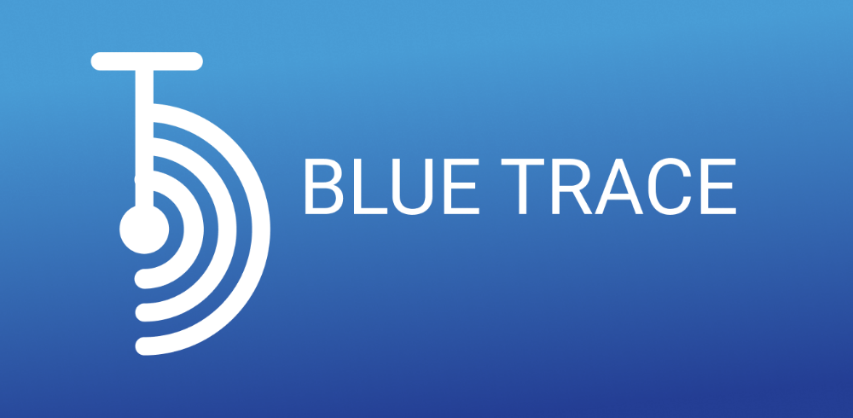
Backgraound
Epidemiological investigation is one of the main means of controlling the outbreak of COVID-19.
The transmission path of epidemic is often based on the individual’s trajectory.
It could be more effective if we can find susceptible population and possible super-spreaders in advance based on historical trajectory data before infection happens.
The application of location-based social networks (LBSNs) can help us understand human movements.
Hong Kong uses the ``LeaveHomeSafe" and Singapore uses the ``BlueTrace" to trace the infections.
Notes:
Since December 2019, COVID-19 has swept through nearly around the world. It is well known that epidemiological investigation is one of the main means of controlling the outbreak of COVID-19. Since the transmission path of epidemic is often based on the individual’s trajectory, many countries recommend the citizens to scan some Quick Response (QR) code to record their daily visits as a diary. A more advanced way is to recommend citizens to install some specific Apps, which are developed particularly for recording users’ trajectories including the visit of time, the latitude and longitude of location, point-of-interest (POI), users’ activities or any other useful attributes if allowed.
For example, Hong Kong uses the ``LeaveHomeSafe" mobile App and Singapore uses the ``BlueTrace" App to trace the infections.
It is expected that information collected by these Apps can help stop the possible spreading of the virus. However, not every one is always willing to share his trajectory. Sometimes they may simply forget to scan the QR codes, or turn off the tracking Apps due to some privacy concern. In the meanwhile, QR-code scan and check-in Apps are inherently passive methods for epidemiological investigation, as only if one person is confirmed to be infected, we can then alert his intimate contacts.
It could be more effective if we can find susceptible population and possible super-spreaders in advance based on historical trajectory data before infection happens. This provides new challenges to the researchers to develop alternative epidemiological investigation models.
This is what we want to investigate in this work. Herein, we believe that the application of location-based social networks (LBSNs) based on the historical data can help us understand human movements, thereby do a better that epidemiological investigation.

Slide 4

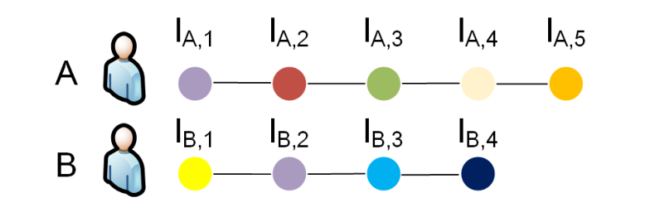
Trajectory with check-in points
User’s mobility can be described by a sequence of check-in points, which includes time and location.
The trajectory of user can be defined as , is the number of check-ins
Point-of-interest (POI) is the property of the physical location, such as school, supermarket, park, etc.
We define users’ activities as behavior-of-interest (BOI), which records the behavior of user, such as:
The reason that this user arrives at this location,
via what kind of transportation he takes to this location,
or how much money he normally spends there,
Trajectory
Notes:
So let us see how to define the LBSN. User’s mobility can be described by a sequence of check-in points, which includes time and location.
We call this sequence a trajectory, denoted by T_i, each entry in T_i is a location the user i visits and all nodes in $T_{i}$ are arranged in chronological order.
In our model, except for timestamp and physical location, a check-in point also contains the point-of-interest ( we call it POI) and users’ behavior-of-interest (we called it BOI).
Herein, the physical location the where the user visits, POI is the property of the physical location, such as school, supermarket, park, bar. We also call it POI semantic, as it is like the sematic of the location.
As for BOI, it represents the behavior of user, such as the reason that this user arrives at this location or how much money he normally spends there. We also call it the sematic of the user’s behavior in this location.
POI and BOI are very important sematic feature we want to analyze in the trajectory sequence.

Slide 5
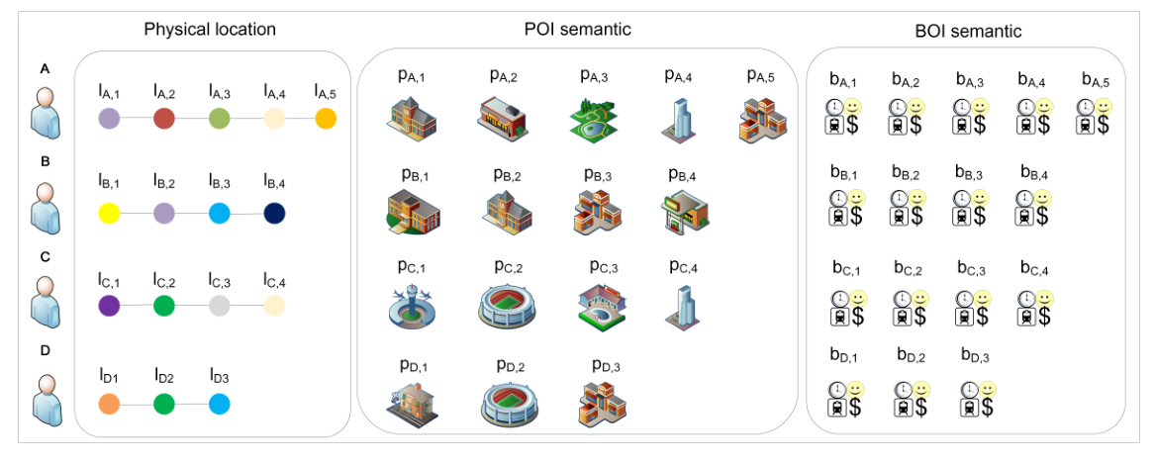
Trajectory with super node
Super node
means the physical location, which represents as (longitude, latitude) tuples.
means the semantic information or attributes of the location.
means the users’ behaviors.
We redefine the trajectory . might be varying with different users.
Physical location, point-of-interest (POI) and BOI are 3 different channels to define the trajectory.
Notes:
The traditional trajectory only contains the location in a chronological order, while in this work we want to include all the location, POI and BOI in the trajectory model.
We therefore define Trajectory with super nodes sorted by time, which are represented as (l,p,b).
Apparently, different users have different trajectory pattern, with different length.
Physical location, POI and BOI are 3 different independent channels to define the trajectory.
Our main work here is to explore how to fuse information on these channels to better understand users’ trajectory, thereby guiding us to do a better epidemiological investigation.

Slide 6
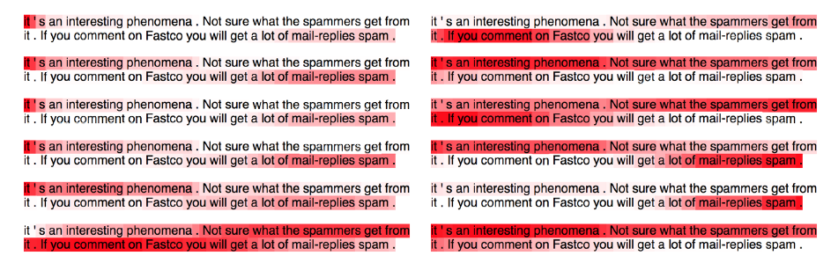
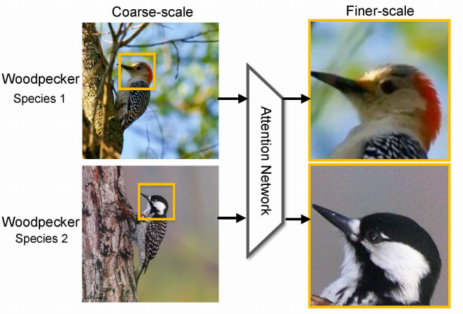
Features extraction motivated by NLP
In the real world, trajectory sequences are often high-dimensional, sparse and not uniformly sampled.
Ref. [1] pointed out that trajectory patterns follow a pow-law distribution, which is similar to language model.
The Embedding Block: map super nodes into low-dimensional space.
The Self-attention Block: extract global feature from highly-related sequences.
Self-attention mechanisms are effective in NLP [3] and CV[4] to extract global feature from highly-related sequences.
[1] H. Gao, J. Tang, and H. Liu, “Exploring Social-Historical Ties on Location-Based Social Networks,” Proceedings of the 6th International AAAI Conference on Weblogs and Social Media, 11 2012.
[2] T. Mikolov, K. Chen, G. Corrado, and J. Dean, “Efficient Estimation of Word Representations in Vector Space,” in 1st International Conference on Learning Representations, ICLR 2013, Scottsdale, Arizona, USA, May 2-4, 2013, Workshop Track Proceedings, 2013.
[3] Jianlong Fu, Heliang Zheng, Tao Mei; Proceedings of the IEEE Conference on Computer Vision and Pattern Recognition (CVPR), 2017, pp. 4438-4446
[4] Lin, Zhouhan & Feng, Minwei & Dos Santos, Cicero & Yu, Mo & Xiang, Bing & Zhou, Bowen & Bengio, Y.. (2017). A Structured Self-attentive Sentence Embedding.
Notes:
Now let us see how we can process the trajectory with super nodes.
In the real world, trajectory sequences are often high-dimensional, sparse and not uniformly sampled. In [1], it pointed out that trajectory patterns follow a pow-law distribution, which is similar to the language model.
Motivated by this, we can refer to the research of NLP such as embedding and attention mechanism to process the trajectory.
Embedding: map super nodes into low-dimensional space.
Self-attention mechanisms: extract global feature from highly-related sequences.

Slide 7
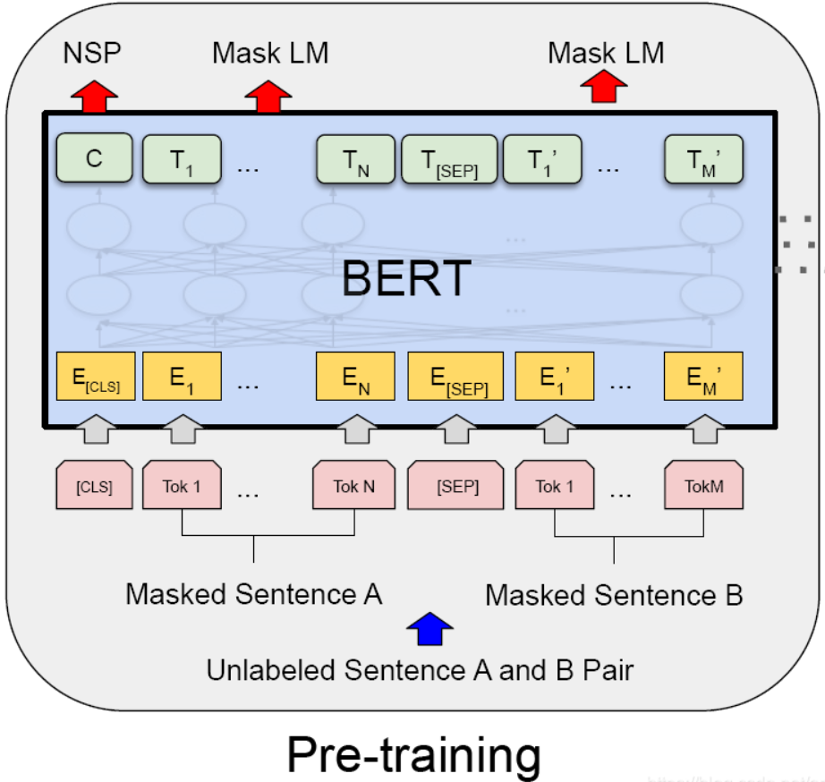
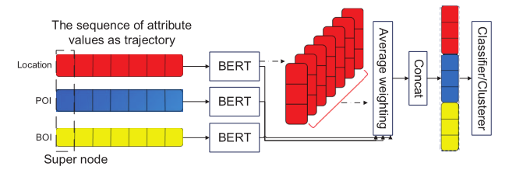
An unsupervised feature-based model
BERT[1] is a novel pre-training model to embed a word into low-dimensional space.
As trajectory sequences have 3 attributes in this work, i.e., 3 different sequences
Mapping model map sequences in trajectory space into vectors.
Different attributes depict the trajectory patterns in different channel.
Fusing the attributes by concatenation, user i’s trajectory pattern can be
Our unsupervised-learning framework
The framework of BERT
[1] J. Devlin, M. Chang, K. Lee, and K. Toutanova, “BERT: Pre-training of Deep Bidirectional Transformers for Language Understanding,” CoRR,vol. abs/1810.04805, 2018.
Notes:
We will propose two types of models in this work. The first one is an unsupervised feature-based model.
In this model, we have three independently channels. Li, Pi and Bi. Each channel has its own sequence of trajectory, representing location, POI and BOI, respectively.
For feastures in each channel, we regard them as tokens in the language and pre-trained them by a we use a bidirectional encoder representations from transformers (BERT) model , which is a
novel pre-training model devised for language processing.
We consider that all channels are equally important, so an average weighting can be applied to fuse them to form a final portrait for each user.
We call this model an unsupervised model as it pre-train each trajectory without the knowledge of the labels.
The pre-training results are vectors to represent each user, which will be fed into the classifier or clusterer for further analyze.
For NLP, unsupervised learning model such word2vec and doc2vec can map high-dimensional and sparse tokens into low-dimensional space.
Recently, the propose of BERT can embed the contextual information into the token, which is state-of-the-art and self-attention based model for a wide range of tasks. BERT alleviates unidirectionality constraint by using a “masked language model” (MLM) pre-training objective. The masked language model randomly masks some of the tokens from the input, and the objective is to predict the original vocabulary id of the masked word based only on its context. The MLM objective enables the representation to fuse the left and the right context, which allows us to pretrain a deep bidirectional Transformer.
er’s portrait then can be fed into classifier or clusterer to predict or analyse.
Compare to traditional CNN and RNN, self-attention can extract global feature and can be implemented in a parallel way.

Slide 8
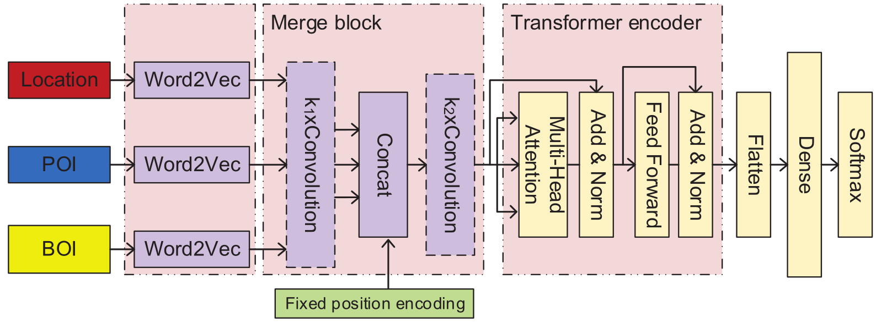
A supervised feature-based model
The label in the data set can make the learning process more targeted.
Inspired by the combination of contextual representation and attention mechanism in BERT, we propose a supervised pre-training model based on a word2vec block, a merge block, and a transformer[1].
Based on the framework of a transformer, we improve the fusion of attributes by adding the merge block.
The merge block is composed of convolution layer and concatenation operation.
Combining with convolution layer, the supervised framework can extract local feature of attributes.
Fixed position encoder provides a code which represents the order of the current token in the sequence.
[1] A. Vaswani, N. Shazeer, N. Parmar, J. Uszkoreit, L. Jones, A. N. Gomez, L. Kaiser, and I. Polosukhin, “Attention Is All You Need,” CoRR, vol. abs/1706.03762, 2017.
Notes:
As for the supervised feature-based model, label information is utilized to embed the trajectory which makes the pre-training process more targeted.
Our supervised pre-training model consists of a word2vec embedding block, a merge block and a transformer.
We first embed each channel of attributes by a word2vec block, whose output is the input of the merge block. The merge block is based on convolution layer and concatenation operation, which can extract local feature of attributes and fuse them to a better feature to analyze.
Fixed position encoder provides a code which represents the order of the current token in the sequence.
Combining with the global feature extracted by transformer, the supervised model can extract more fine feature for the future classifier or clusterer.
Herein, the parameters in the Merge block and transformer block will be updated guided by labels, and this it is a supervised model.
Similar to the unsupervised pre-training model, the pre-training results are vectors to represent each user, which will be fed into the classifier or clusterer for further analyze.

Slide 9
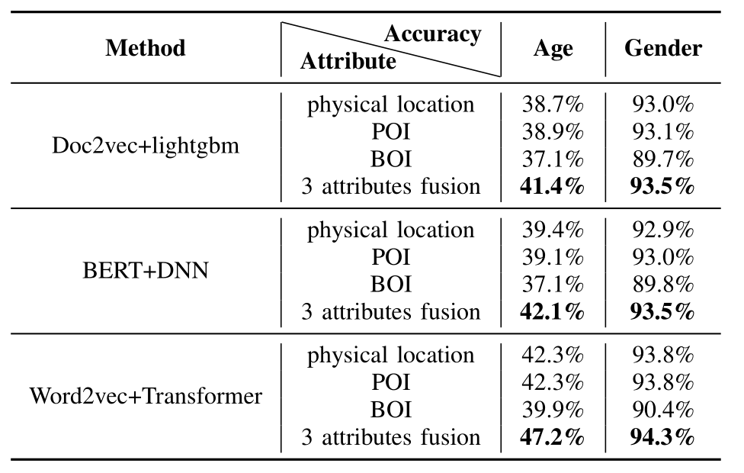
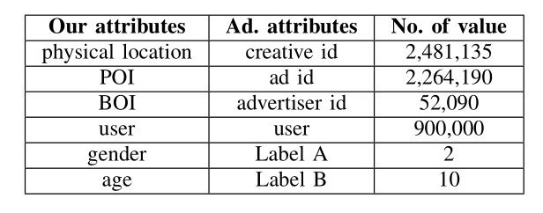
Numerical results on synthetic data
The synthetic data with true labels
Based on the similarity between real advertising system and the check-ins in trajectory, we consider user’s click sequence as the trajectory. The attributes of advertisement are analog to POI and BOI information in the trajectory model.
The user’s age and gender information are considered as Label A(binary-classification) and Label B(multi-classification).
Evaluate the unsupervised and supervised pre-training models.
Doc2vec[1] + lightgbm[2]
BERT + DNN
Word2vec[3] + Transformer
The fusion by multi-features
The detail of synthetic data set
[1] Q. Le and T. Mikolov, “Distributed Representations of Sentences and Documents,” in Proceedings of the 31st International Conference on Machine Learning, vol. 32, no. 2, 2014, pp. 1188–1196.
[2] G. Ke, Q. Meng, T. Finley, T. Wang, W. Chen, W. Ma, Q. Ye, and T.-Y. Liu, “LightGBM: A Highly Efficient Gradient Boosting Decision Tree,” in Advances in Neural Information Processing Systems, vol. 30, 2017,
pp. 3146–3154.
[3] T. Mikolov, K. Chen, G. Corrado, and J. Dean, “Efficient Estimation of Word Representations in Vector Space,” in 1st International Conference on Learning Representations, ICLR 2013, Scottsdale, Arizona, USA, May 2-4, 2013, Workshop Track Proceedings, 2013.
Notes:
Here we will show our numerical results of the unsupervised and supervised pre-training model on synthetic data.
The synthetic data is generated from a real advertising system. In this ad system, each user visit different advertisement, each ad has its own features. Each user also has its own features. Based on the similarity between real advertising system and the check-ins in trajectory, we consider user’s click sequence as the trajectory. The attributes of advertisement and users are analog to POI and BOI information in the trajectory model.
The user’s age and gender information are considered as Label A(binary-classification) and Label B(multi-classification). These two labels could be
The detail of synthetic data set is shown in the left table.
In the right table, we can see the fusion results by our fusion scheme, as for the unsupervised model, we can also replace the pre-train model BERT by a simple Doc2vec block, which is also unsupervised.
From the table we see that, comparing to only using attributes in one channel, fusing three channels in unsupervised model or supervised model can improve the accuracy of the classifier by at most 5%. This implies that jointly using location, POI and BOI information can improve the performance of the trajectory model.
This series of experiments show that the multi-attribute trajectory can represent users' preferences and relationships.
Therefore, in the application of epidemiological investigation, one can label users according to different purposes and make further prediction.

Slide 10
The convergence results
Doc2vec+lightgbm
BERT+DNN
Word2vec+Transformer
Notes:
The training log and convergence are also shown in these 3 figures.
We show the convergence of the training process. In each epoch, the proposed model is trained on a complete training set. From the figures, we see that after several epochs, the performance of classifiers becomes stable. A DNN classifier converges much faster than tree-based ensemble learning classifier. The fusion of different attributes can indeed improve the performance, especially in the multi-classification task.

Slide 11
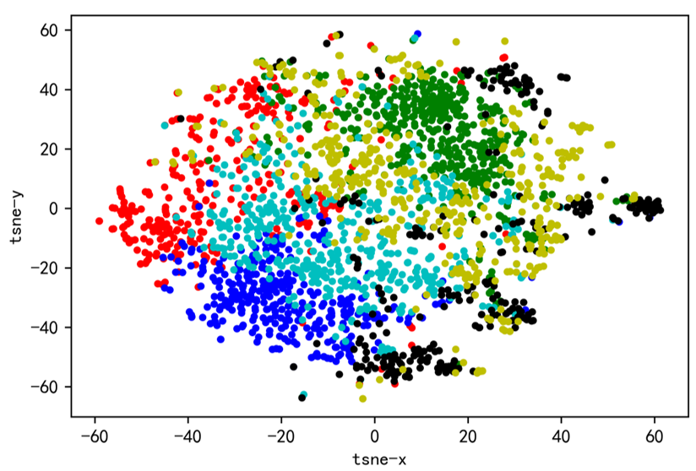
Results on the real data
The foursquare data set is one of the examples of LBSNs, users can check in or report their locations while sharing their social life.
Tokyo data set collected the check-ins from 12 April 2012 to 16 February 2013, which contains where and when the user visited this location, as well as POI.
As for BOI, we divide a week into 168 hours, BOI is represented as any one of 168 hours according to their timestamp.
As the lack of proper labels in the data set, the unsupervised model with a clusterer (k-means) is applied to analyze users’ portraits.
Notes:
As for the real-world data, we adopt the foursquare data set.
This data set contains check-ins in Tokyo collected for about 10 month (from 12 April 2012 to 16 February 2013). There are in total $573,703$ check-ins, which contain about the specific location where the user visited, the timestamp when the user visited this location, as well as POI, i.e., the concrete category of location. We use the timestamp to construct the BOI attribute by summarizing users' timeslots where users frequently appear at this location. Specifically, we divide a week into $168$ hours, and users' behavior will be represented as any one of $168$ hours according to their timestamp. As we don't have proper labels in this data set, a clusterer is applied to analyze users' portraits.
We adopt the unsupervised pre-training model to find each user's portrait vector. Then, we applied a k-means algorithm and visualize the results by a t-SNE in 2-D space. Note that herein the number of clusters is estimated by an Eblow method \cite{thorndike1953belongs}.

Slide 12
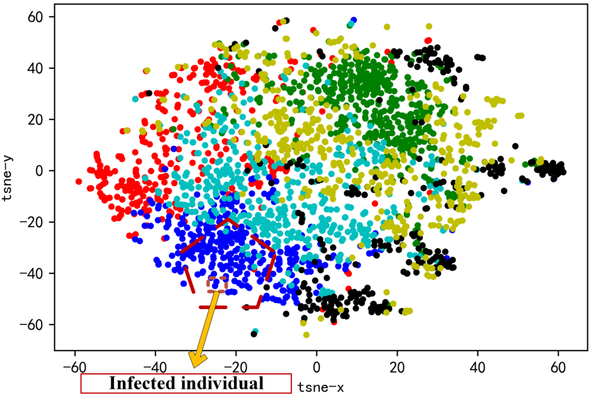
The clustering result for COVID-19
The visualization is based on t-SNE[1].
The similarities and differences of trajectory patterns can be explored by their clustering result.
As for the control of epidemic, we can identify key users for supervision and devise more advanced strategies for the control of epidemic.
[1] L. van der Maaten and G. Hinton, “Visualizing data using t-SNE,” Journal of Machine Learning Research, vol. 9, no. 86, pp. 2579–2605, 2008.
Notes:
This results can help us to explore the similarities and differences of trajectory patterns among users. For example, in this figure, if a group of people in the same cluster are infected, we can find the individuals that are more suspicious to be affected by using their trajectory patterns, which are nodes with the same color in this fugure. In this way, we can identify key users for supervision and devise more advanced strategies to control the pandemic.

Slide 13
Conclusion & Future work
Provided two frameworks to extract users' preferences and relationships from trajectories with multi-attributes.
Mining trajectory patterns with POI and BOI can help analyze users’ trajectory.
Unsupervised or supervised pre-training models are proposed. Provide two approaches to find the users’ portraits from trajectories.
Apply the proposed model on both synthetic data and real data sets.
In the future, we will integrate propagation model such as SEIR into our model, try to explore a feasible way to combine data-driven and model-driven methods.
Notes:
In this paper, we provided two frameworks to extract users' preferences and relationships from trajectories with multi-attributes. Each attribute sequence is embedded with unsupervised or supervised pre-training blocks, then fed to a classifier or a clusterer for different tasks. By evaluating the proposed frameworks on synthetic and real data sets, we prove that fusing multiple attributes can help improve the accuracy in the binary-classification or multi-classification tasks. This provides us a feasible way to better mine trajectory for controlling the epidemic.

Slide 14
Thanks for your attendance！

